Slide 1

A SEMINAR On ‘Integration of Human Collaboration in Robotic Welding for Mistake Proofing’
Mechanical Engineering Department
Guided by
Prof. R.V.Bhaskar
Submitted by
Ms. Komal Jagannath Patil

Slide 2
INTRODUCTION
A robot carries out a task done by human being. Hence the robot which works with human being can be called as Human Robot Collaboration (HRC).
Robot welding is the use of mechanized programmable tool (i.e. Robots) which completely automates a welding process but both performing the weld & handling the parts.
Today’s HRC technique used in robotic welding fitted with a variety of integrated sensors.
semiautomatic & fully automatic welding results in increased arc time factor & higher productivity. But advantage of these processes cannot be fully exploited unless Jigs & Fixture & Manipulator which are properly integrated with welding equipment & work piece are devised

Slide 3
ROBOT WELDING
Robot welding is the use of mechanized programmable tool (i.e. Robots) which completely automates a welding process but both performing the weld & handling the parts.
Welding is the most economical & efficient way to join metals permantly. A weld is produced either by heating the materials to welding temperature with or without the application of pressure alone with or without the user of filler metal.
Types of Robotic Welding :
1) Arc Welding
2) Spot Welding

Slide 4
ARC WELDING
The Arc Welding uses electric arc as a heat source.
Playback controlled type robots are used for arc welding because they can repeat a task accurately along a taught welding line.
Automatic arc welding normally involves high duty cycles, and the welding equipment must be able to operate under those conditions
A special kind of electrical power is required to make an arc weld.
All arc-welding processes use an arc welding gun or torch to transmit welding current from a welding cable to the electrode.
The productivity of the robot-welding cell is speeded up by having an automatically rotating or switching fixture, so that the operator can be fixing one set of parts while the robot is welding another.

Slide 5
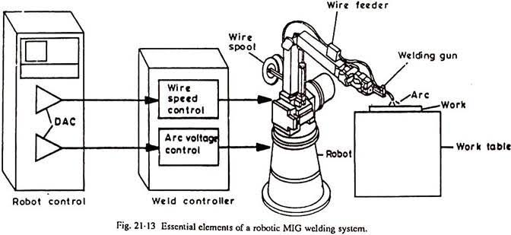
WELDING SETUP
1. Arc welding robot 2. Power source 3. Welding torch 4. Wire feeder 5. Welding fixtures
6. Torch cleaner

Slide 6
SPOT WELDING
Resistance Spot Welding (RSW) is a process in which contacting metal surface points are joined by the heat obtained from resistance to electric current.
It is a subset of electric resistance welding.
Workpiece are held together under pressure exerted by electrodes.
The process uses two shaped copper alloy electrodes to Copper Alloy Electrodes to concentrate welding current into a small “spot” & to simultaneously clamp the sheets together.
Forcing a large current through the spot will melt the metal & form the weld.
Projection welding is often used to weld studs, nuts, and other threaded machine parts to metal plate. It is also frequently used to join crossed wires and bars

Slide 7
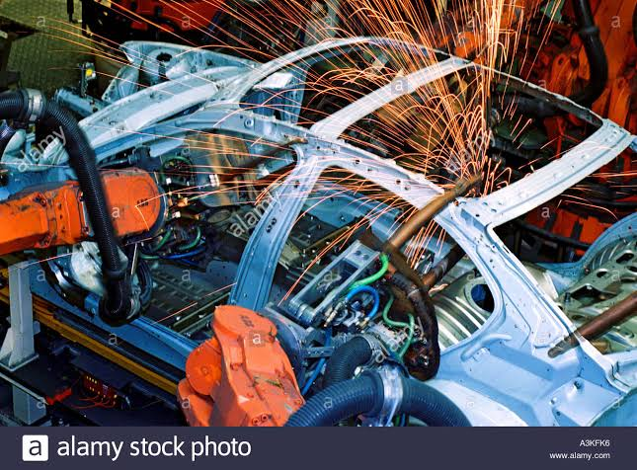
SPOT WELDING SETUP
1) Spot welding robot
2) Spot welding gun
3) Weld timer
4) Electrode tip dresser
5) Spot welding swivel

Slide 8
SENSORS
The main use of sensors in robotic welding is to detect and measure process features and parameters, such as joint geometry, weld pool geometry and location, and online control of the welding process.
sensors provide information like-
Recognition data (to understand the shape, size & features of object).
Orientation data (the position of the object in relation to the robot arm coordinates in the absolute mode).
Physical interaction data (to understand the intensity interaction between the end effectors & the object).

Slide 9
TYPES OF SENSOR
There are two types of sensor :
1. Tactile Sensor :Tactile sensors can be used to sense a diverse range of stimulus ranging from detecting the presence or absence of a grasped object to complete tactile image.
Typical Contact Type Robotic Sensors include:-
a) Force Sensor
b) Torque Sensor
c) Touch sensor
d) Position Sensor

Slide 10
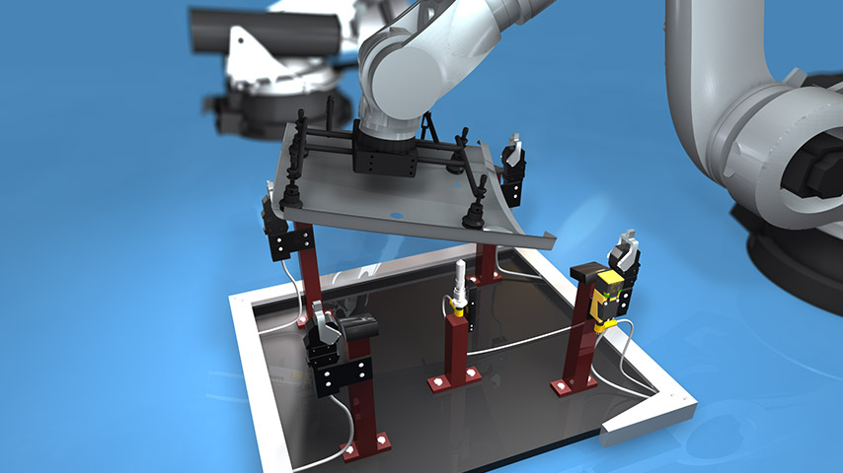
2. Non-Tactile Sensor :
These are contactless sensors which sense the signals remotely, but only within the specified range of distance from the object.
Typical Non-Contact Sensor include:-
1) Proximity Sensor
2)Magnetic Sensor
3)Electro-optical Vision Sensor
4)Ultrasonic Sensor

Slide 11
FIXTURE
Semiautomatic & fully automatic welding result in increased arc time factor & high productivity, but the advantages of this processes cannot be fully exploited unless jigs, fixture & manipulator which are properly integrated with the welding equipment & workpiece are devised.
Use of jigs & fixtures:
1. To minimize distortion cost by heat of welding
2. To permit welding in a more convenient position
3. To increase welding efficiency & productivity
4. To minimize fit-up problem

Slide 12
CASE STUDY
PROBLEM STATEMENT :
To introduce Poka-yoke for installation of Sensor in welding to avoid detect part Hole Missing & reduce time.
POKA-YOKE :
Poka-yoke is a Japanese term that means "mistake-proofing" or "inadvertent error prevention“.
Its purpose is to eliminate product defects by preventing, correcting, or drawing attention to human errors as they occur.

Slide 13
Implementation in manufacturing :
Poka-yoke can be implemented at any step of a manufacturing process where something can go wrong or an error can be made.
For example, a fixture that holds pieces for processing might be modified to only allow pieces to be held in the correct orientation.
2. Sensor Driven Error Proofing :
Many people are recognizing that the most effective, cost-efficient, error-proofing programs integrate sensors in the manufacturing process to eliminate errors through 100% inspection.
The role of sensors now not only relates the quality of parts or products being manufactured, but directly to overall system efficiency.

Slide 14
Previous Status :
In previous condition welding was done manually without using any sensor. Hence, because of operator negligence pin is not qualified to hole due to missing of hole in part.
ANALYSIS:
First they don’t have fixture at that time they were not able to detect the hole in pin but they used to do welding & the time of assembly they came to know that some holes are missing.
So they had to resend the part at the hole making section. So they analysis the problem & they found one solution over it.
They install sensor on the fixture to avoid missing holes.
Only after all four pins are inserted properly in the hole then & then only CO2 welding machine will start & if any one of the pin is missing CO2 welding machine will not get start.

Slide 15
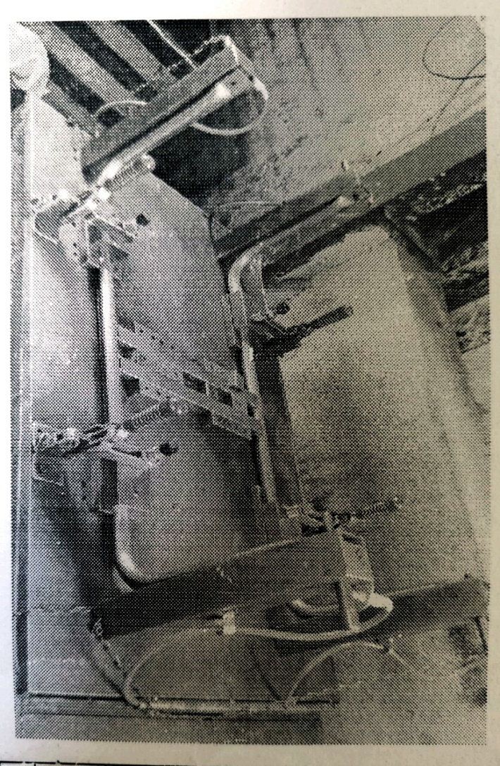

Slide 16
BENEFITS :
Less time spent on training workers.
Elimination of many operations related to quality control.
Unburdening of operators from repetitive operations.
Promotion of the work improvement-oriented approach and actions.
Immediate action when a problem occurs;
100% built-in quality control.
2. RESULT :
Due to use of sensors, we get less number of rejected parts. Thus working will be efficient & productivity increases.

Slide 17
ADVANTAGES
Cycle times are shorter.
Reliability and quality are improved.
Better floor space utilization.
Reduced waste.
Workplace safety is increased and improved
The welding is done by robots due to this manufacturing line becomes more efficient.

Slide 18
REFERENCES
J. Ogbemhea*, K. Mpofub, N.S Tlalec, “Achieving Sustainability in Manufacturing Using Robotic Methodologies”, 14th Global Conference on Sustainable Manufacturing, GCSM 3-5 October 2016, Stellenbosch,South Africa
R. Förstmanna,*; J.Wagner a; K. Kreisköther a; A. Kampker a; D. Busch,
“Design for Automation: The Rapid Fixture Approach”, 27th International Conference on Flexible Automation and Intelligent Manufacturing, FAIM2017, 27-30 June 2017, Modena, Italy
Roman Gerbersa*; Markus Mückea; Franz Dietricha; Klaus Drödera, “Simplifying robot tools by taking advantage of sensor integration in human collaboration robots”, 6th CIRP Conference on Assembly Technologies and Systems (CATS)
R.K. JAIN, “Production Technology”, Manufacturing Processes, Technology, Automation, Khanna publication, Seventeenth Edition, Page No.944-961.
Er. R. K. RAJPUT, “A Textbook of Mechtronics”, S. Chand Publications, Third Edition, Page No. 43-187.
Dr. O. P. KHANNA, “Welding Technology”, Dhanpat Rai, First Edition, Page No.600-612.

Slide 19
THANK YOU !

